Slide 1


.NET Core Enterprise Application Architecture
Pune DevCon 2018
Ziaullah Khan, PFE
Pradeep Nair, Sr. PFE
Services

Slide 2
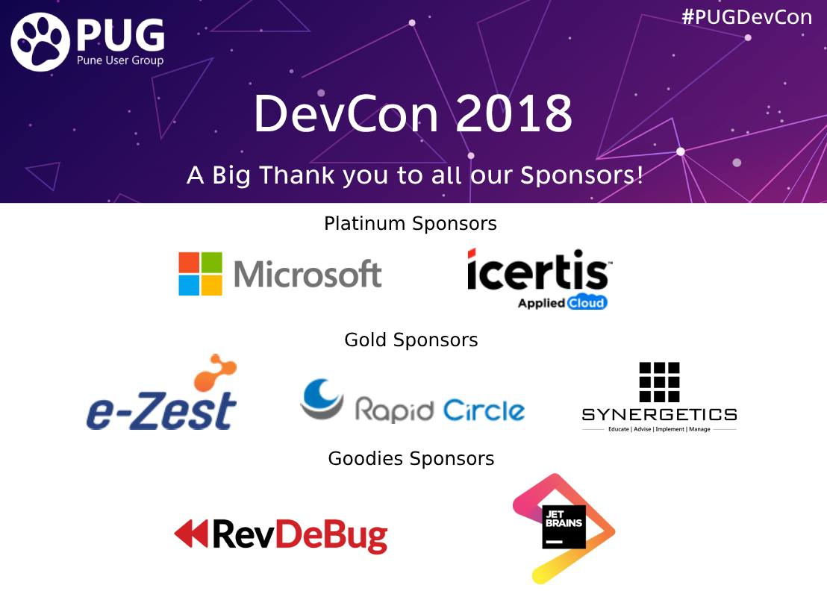

Slide 3

Pradeep Nair Sr. PFE Microsoft Services
17+ years of Software Development Experience in Microsoft Technology
Worked with various MNC before joining Microsoft 5+ year back
Microsoft Certified Trainer
MCSD, MCSE, MCP
Certified Azure Solution Architect
TOGAF(9.1) Certified Enterprise Architect
Technology Coverage
.Net Core, MVC 6, WebAPIs
Azure IaaS/PaaS Solution/Services
Office 365, SharePoint, ODFB
OSS (Docker, Kubernetes)
BTW, I am an Ex-Soldier from Indian Air Force

Slide 4

Ziaullah Khan PFE Microsoft Services
12+ years of Software Development Experience in Microsoft Technology
Technology Coverage
C#, .Net
ASP.Net, MVC
WCF
Delivered 50+ Projects

Slide 5
Agenda
Computer Evolution – Hardware-to-Software
Programming Paradigm
Programming Principles
Design Patterns & DDD
Architectural Aspects
Architecture Style
Enterprise Architecture using .Net Core
References
Notes:
Talking Points
How have we reached here – Computer Evolution
Talk about some the Programming Paradigm which is there since ages

Slide 6
Computer Evolution
Notes:
Talking Point
The guy who innovated a wheel wasn’t a genius. Genius was the one who added the other three and made a car.

Slide 7
When did we
first think
of creating a
Computer?

Slide 8

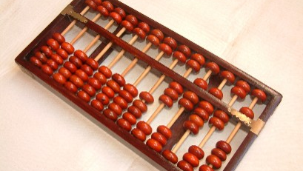
The Abacus
#PuneDevCon

Slide 9
2700–2300 BC
Notes:
The period 2700–2300 BC saw the first appearance of the Sumerian abacus
The use of the word abacus dates before 1387 AD

Slide 10
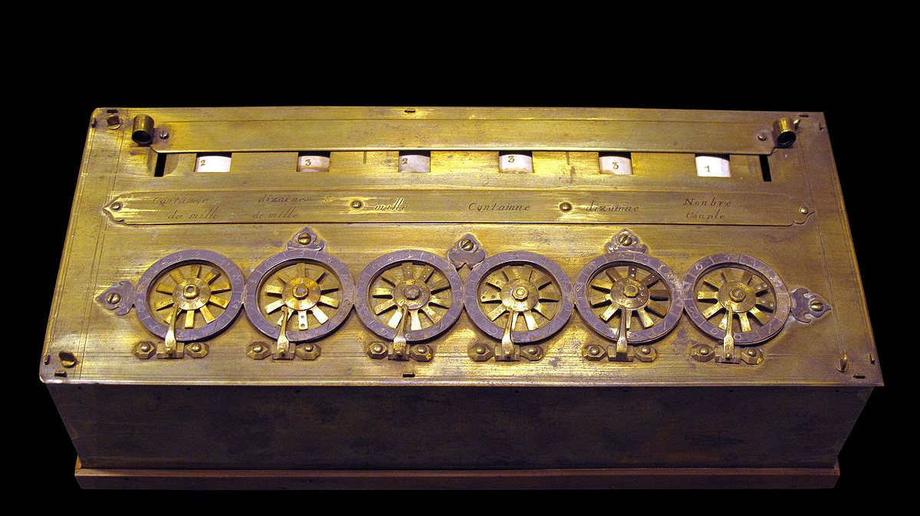
First Calculator
#PuneDevCon
Notes:
- Pascal Calculator

Slide 11
1642

Slide 12
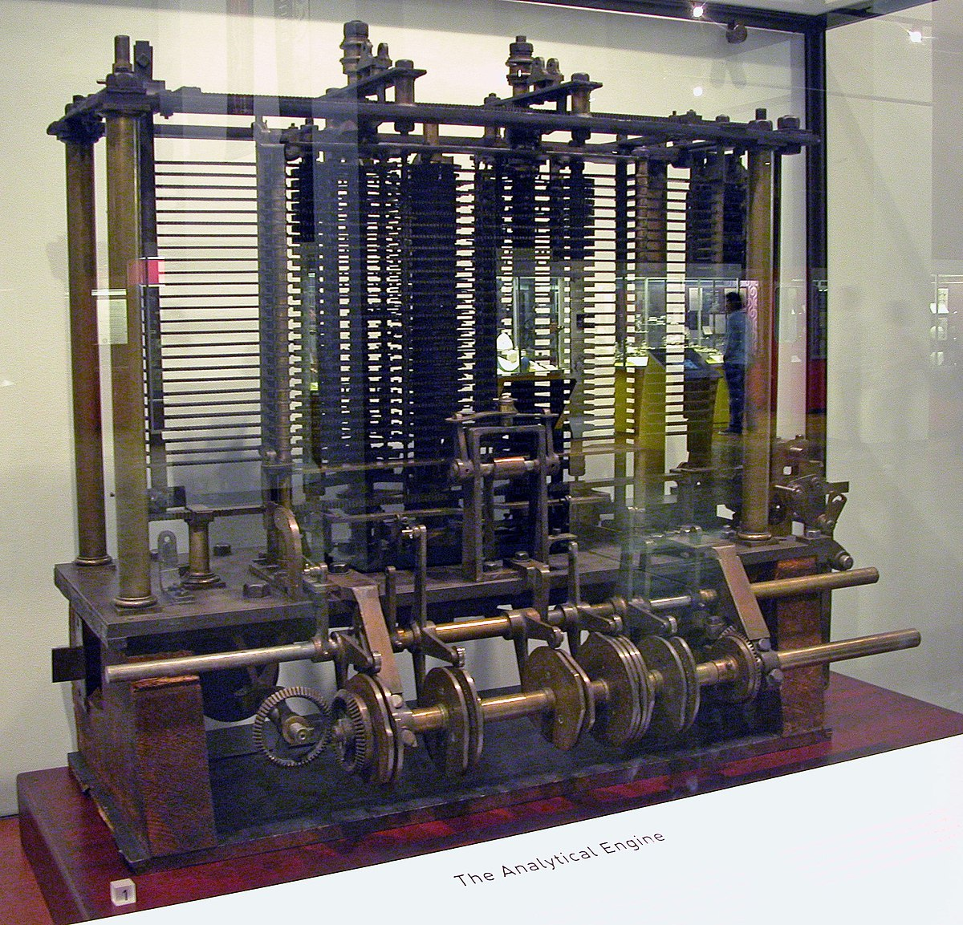
The Analytical Engine
#PuneDevCon
Notes:
The Analytical Engine was a proposed mechanical general-purpose computer designed by English mathematician and computer pioneer Charles Babbage
It was Mechanical Computer uses Punch Card (No instruction set and storage mechanism_)
Babbage is not known to have written down an explicit set of instructions for the engine in the manner of a modern processor manual. Instead he showed his programs as lists of states during their execution, showing what operator was run at each step with little indication of how the control flow would be guided.

Slide 13
1837

Slide 14
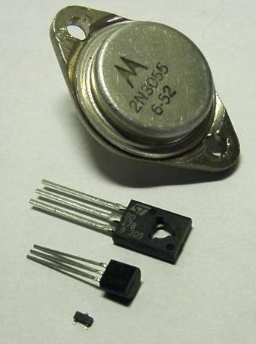
First Transistor

Slide 15
1907

Slide 16
What ended the World War II ?

Slide 17
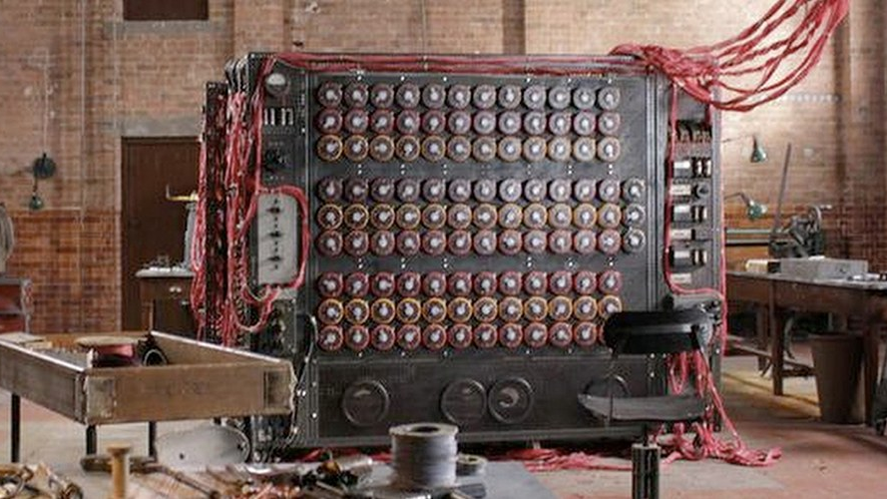
Alan Turing Machine
#PuneDevCon
Notes:
Talking Points

Slide 18
1945

Slide 19
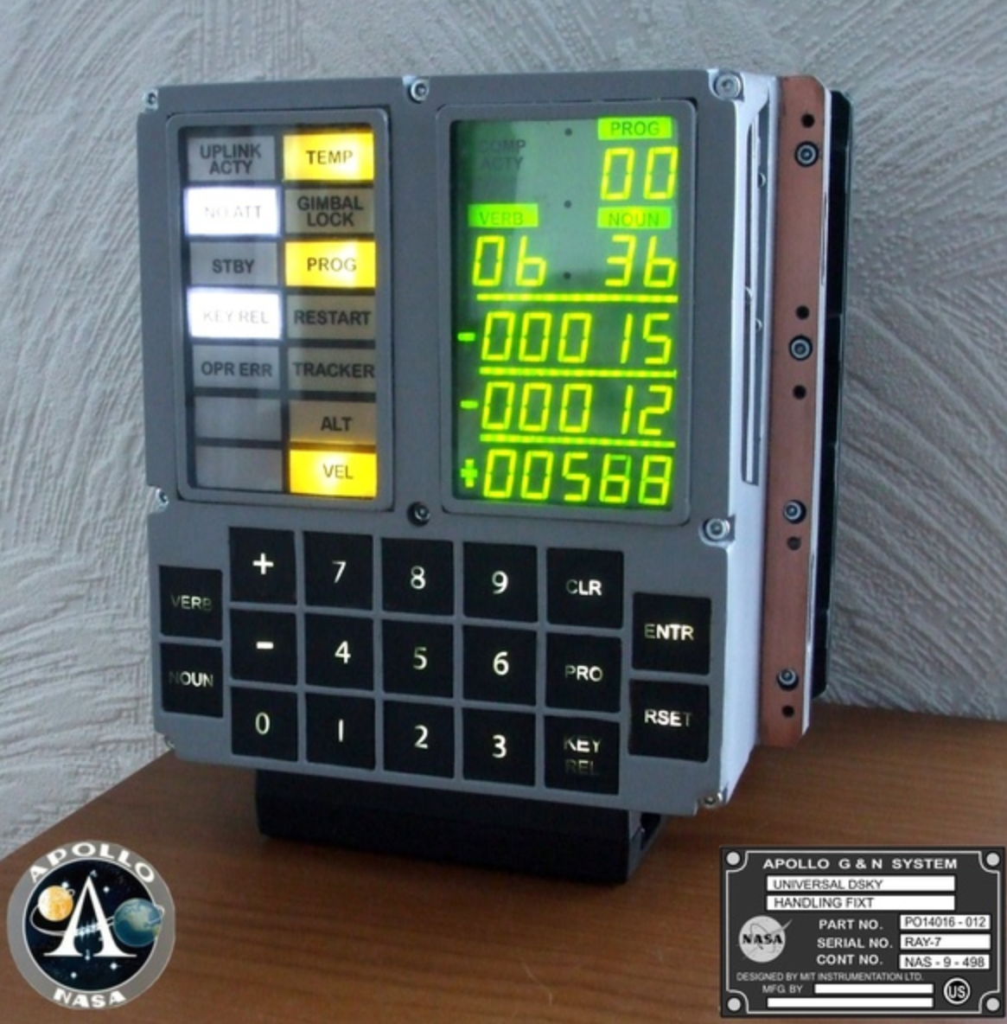
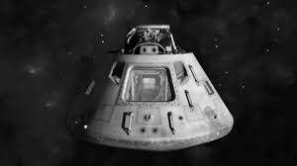
Lunar Module - AGC

Slide 20
How Powerful was the computer of Apollo 11?
Notes:
Talking Points
4100 ICs with 12,300 transistor
# of transistors - iPhone has 130,000 times more than Apollo
clock frequency - iPhone is 32,600 times faster than Apollo
instructions per second - iPhone is 80,800,000 times faster than Apollo
overall performance - iPhone is 120,000,000 times faster than Apollo

Slide 21
1969

Slide 22
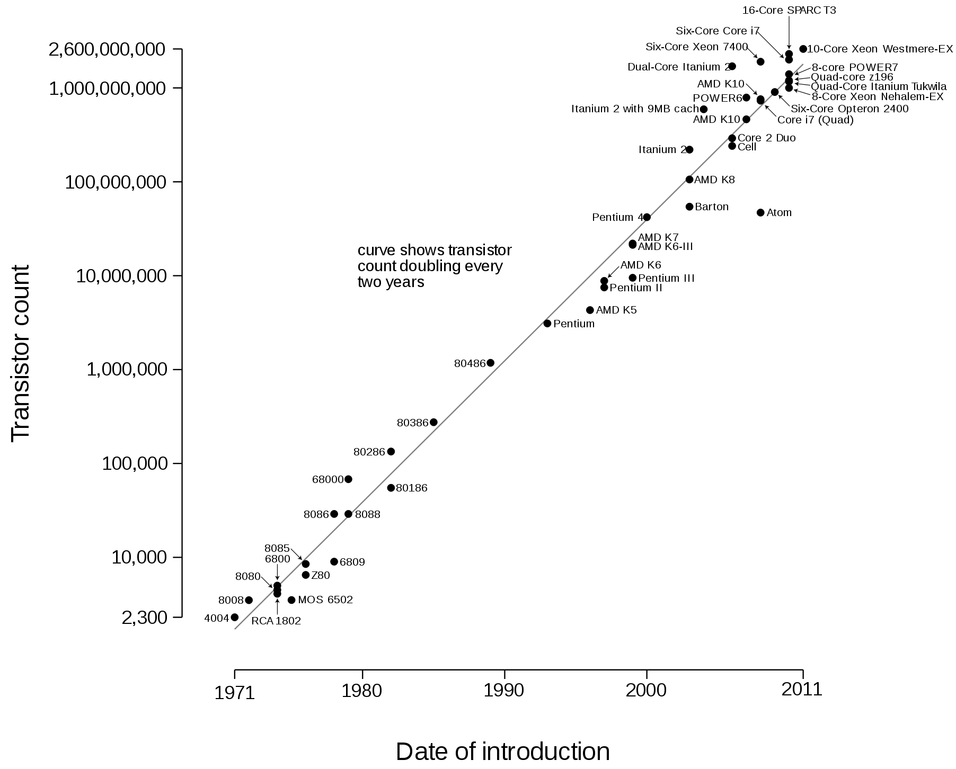
Microprocessor transistor counts 1971-2011 & Moore’s Law
#PuneDevCon
Notes:
Talking Points
18 month logic

Slide 23
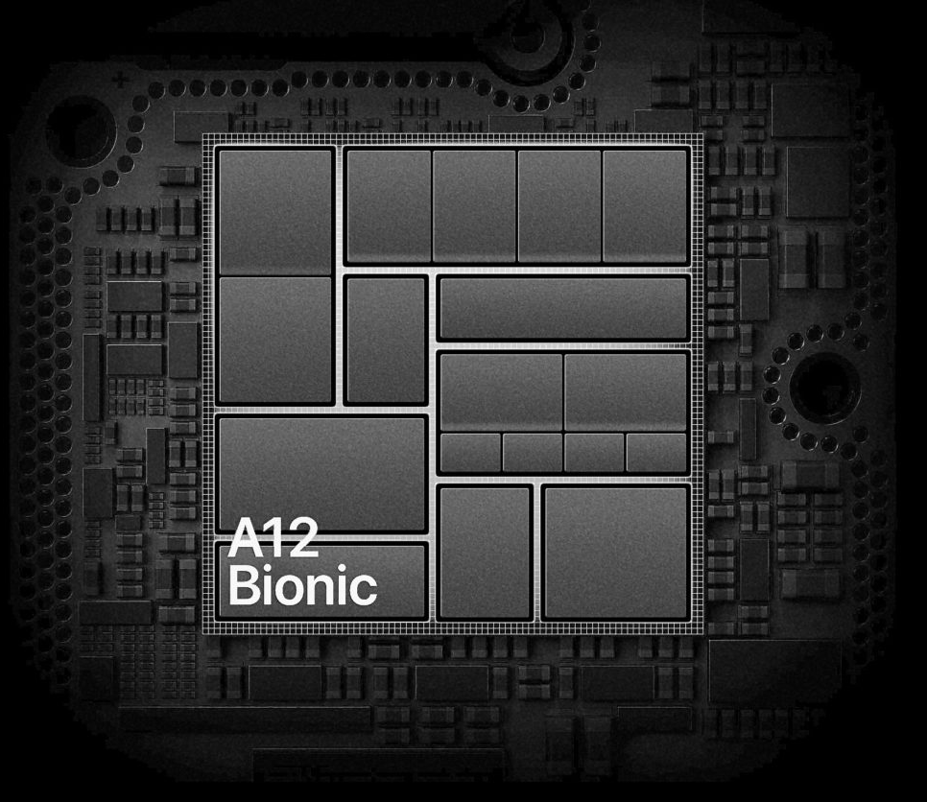
Notes:
Talking Point
Most Powerful Processor (Commercial available)

Slide 24
6,900,000,000 Transistor
Notes:
Talking Points
If stack all the transistor ¼ the distance to the moon

Slide 25
What is Wrong with Hardware?
Notes:
Talking Points
Every change is breaking change
No Memory

Slide 26
Soft-ware
“……Software was invented to be “soft.” It was intended to be a way to easily change the behavior of machines. If we’d wanted the behavior of machines to be hard to change, we would have called it hardware.”
- Uncle “Bob”
Notes:
Talking Points
Telsa Example
Hardware lack memory
Software has plasticity

Slide 27
Programming Paradigm
Notes:
- Talking Points

Slide 28
Structured Programming
Object Oriented Programming
Functional Programming

Slide 29
Structured Programming

Slide 30
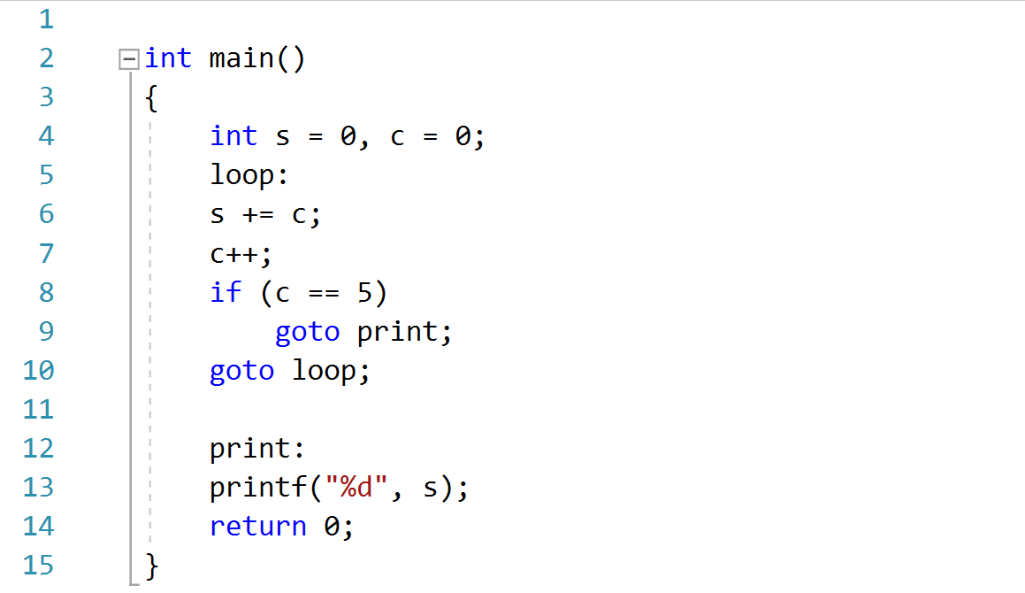
#PuneDevCon

Slide 31
goto

Slide 32
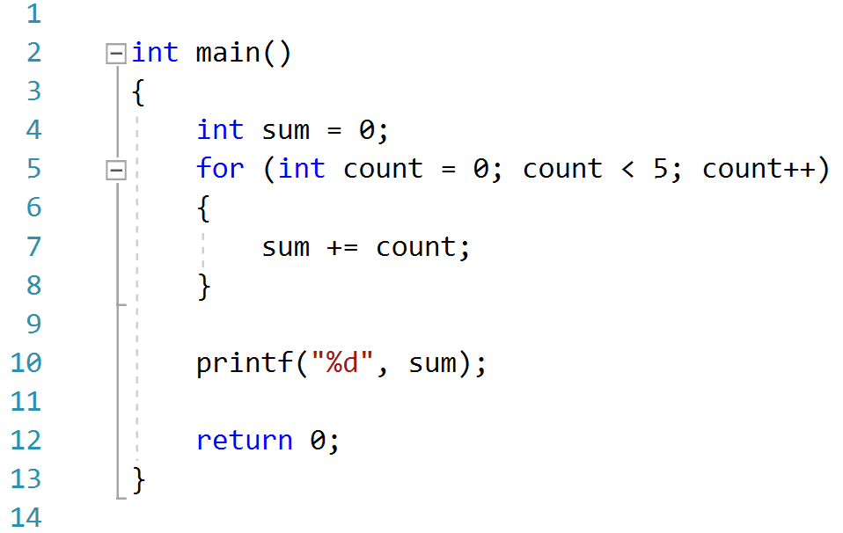
#PuneDevCon

Slide 33
if
then
else
do
while
until
Notes:
Talking Points
Control Flow Statements
12 yrs to replace goto and convivence that goto are bad (direct transfer of controls)
Transfer control in specific conditions

Slide 34
1968
Notes:
- Someone had published article in technology article

Slide 35
Edsger Wybe Dijkstra
Notes:
Talking Point
First register Programmer

Slide 36
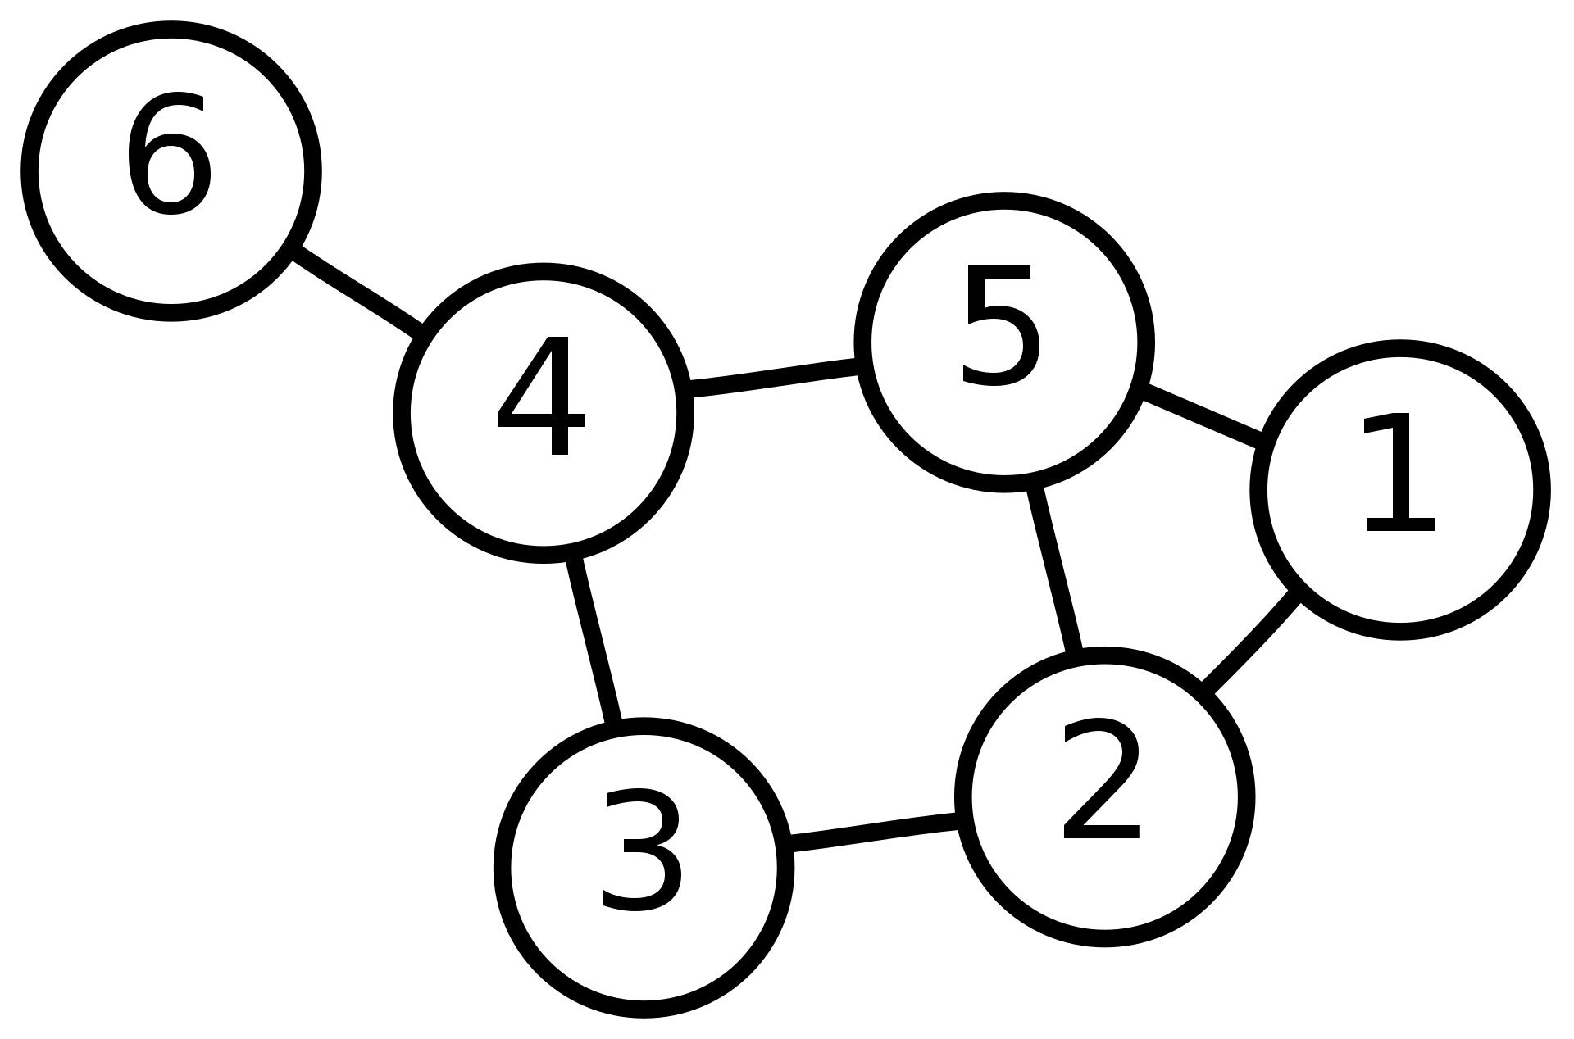
Notes:
Talking Point
Shortest Path Algorithm (Google Maps)

Slide 37
Do Not
Directly Transfer Control
Notes:
Talking Points
SP tell what you should never do

Slide 38
Object Oriented Programming
Notes:
Definition : Modeling the real world….Encapsulation..inheritance…polymorphysim

Slide 39
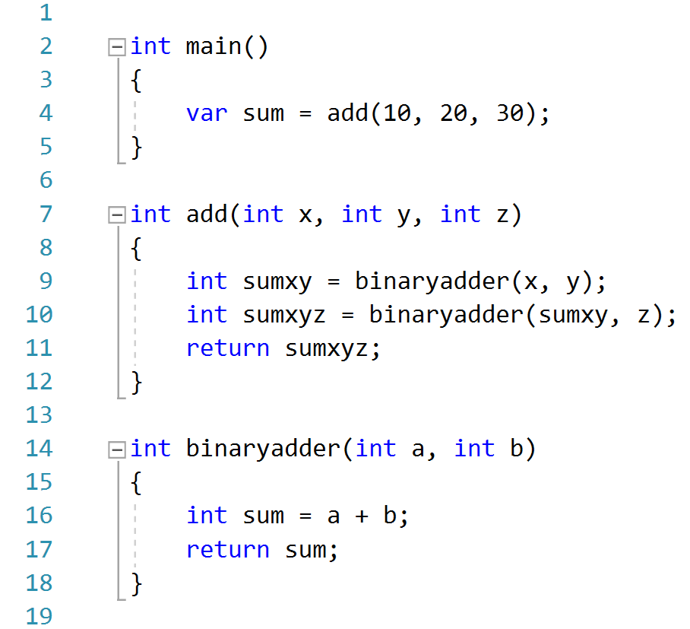
#PuneDevCon
Notes:
Talking Point
Heap Vs Stack

Slide 40
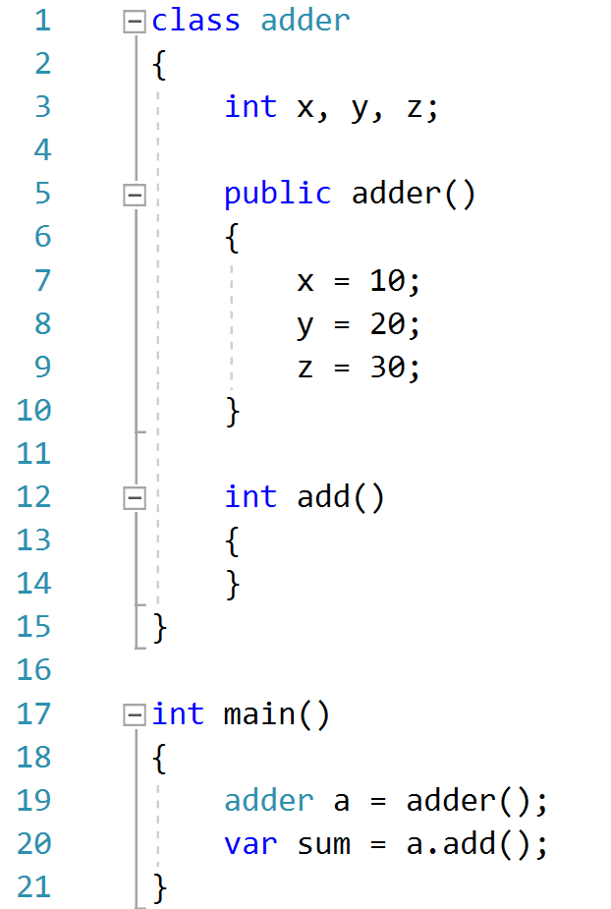
#PuneDevCon
Notes:
Encapsulation
Data (Hidden) & Function (Exposed) Encapsulated
“C” Vs “C++” (only Polymorphism which is brought in by C++ or OO)
Inheritance
Redeclaration of Variable and Function
Polymorphism
Pointer to Functions (Von Neuman did this in 1940 as well)
OO didn’t gave Polymorphism but it made is much safer/more convenient.
Impose discipline on indirect transfer of control
Dependence Inversion brought out the power of OOP
Copy & Device Driver Example ( Plugin Architecture)
Independent Deplorability

Slide 41
1966

Slide 42
Ole Johan Dahl & Kristen Nygaard

Slide 43
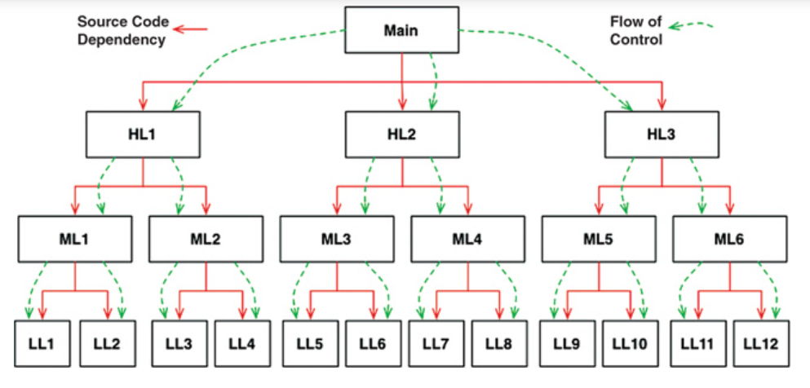
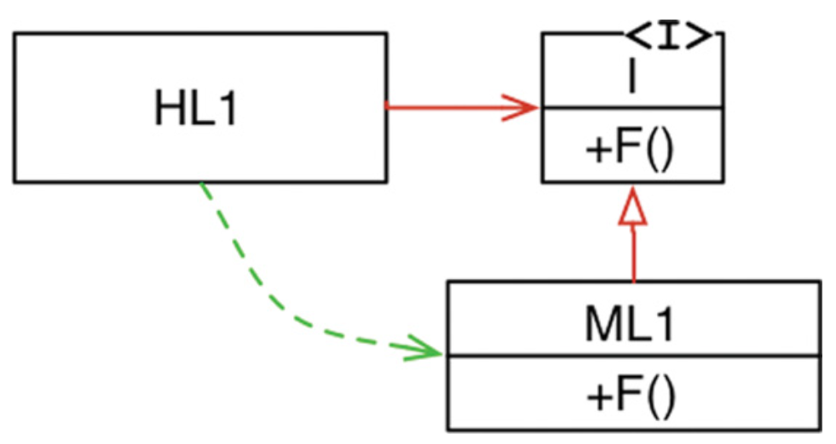
Notes:
Talking Point
Main function knows too much about low level dependencies
Dependency direction is changed

Slide 44
Do Not
Use Polymorphism through Function Pointers
Notes:
Talking Point
What ability is taking away

Slide 45
“C makes it easy to shoot yourself in the foot; C++ makes it harder, but when you do it blows your whole leg off.” -Bjarne Stroustrup
OOPs
Notes:
Talking Points
C++ design time is more than C (factor of 5)
If want to use the full Potential of C++ spent time to design else use C language.

Slide 46
Functional Programming
Notes:
Talking Points
It Predate Programming Itself
Considering mutability of the Variable
And all problems are because of mutable variable
race condition,
deadlock condition
concurrent updates

Slide 47
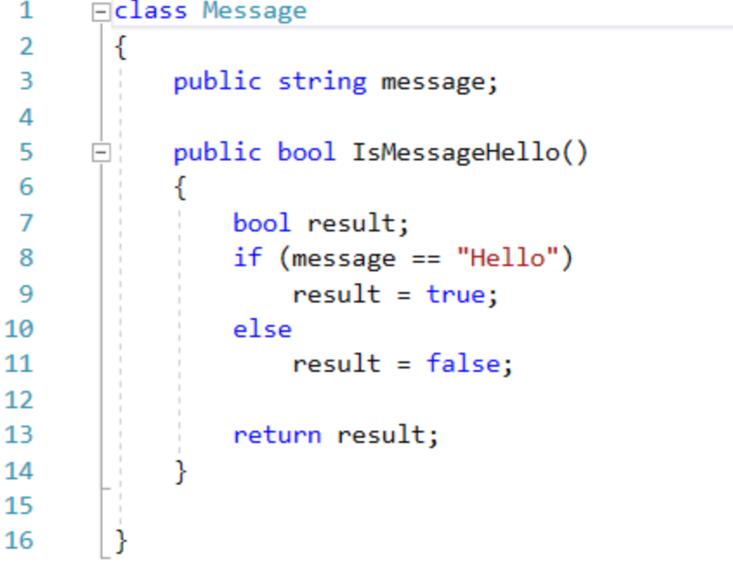
#PuneDevCon

Slide 48
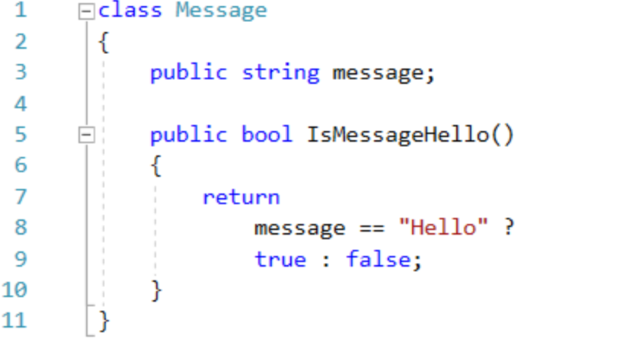
#PuneDevCon

Slide 49
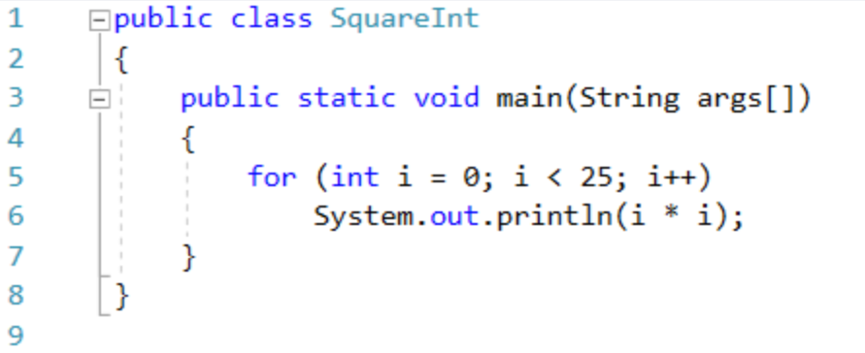
#PuneDevCon

Slide 50
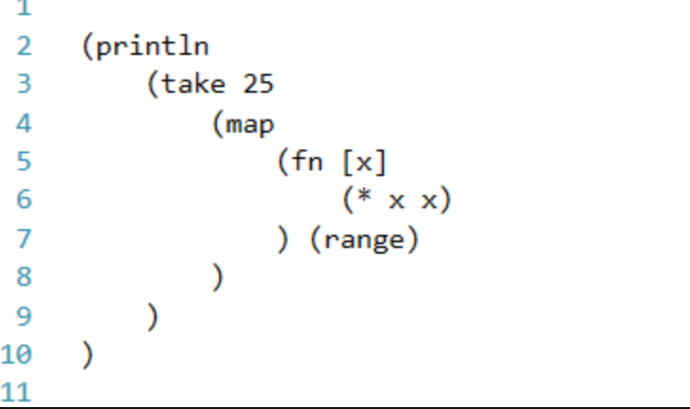
#PuneDevCon
Notes:
(println ;___________________ Print (take 25 ;_________________ the first 25 (map (fn [x] (* x x)) ;__ squares (range)))) ;___________ of Integers

Slide 51
1936
Notes:
Talking Points
Date back to 1936

Slide 52
Do Not
Vary your Variable with Assignment
Notes:
Talking Points
Change it through Projections [using LINQ (Where / Select ) Extension Methods]
Use Read-only parameter (only assigned in constructors)

Slide 53
Each of the paradigms
removes
capabilities
from the programmer

Slide 54
..But they Impose
Discipline

Slide 55
Paradigm’s Impact on Architectural Thinking
Structural Programming ➔Algorithmic Foundation
Object Oriented Programming ➔Architectural Boundaries
Functional Programming ➔Data Access
Notes:
Talking Points

Slide 56
What does this history lesson
on paradigms have to do with
Architecture?
Notes:
Talking Points
Everything, because its solves main Architecture concerns
And they are..solving 3 problems in the EA domain

Slide 57
Function
Separation of Component
Data Management
Notes:
Talking Points
Three Problems

Slide 58
CODING – S.O.L.I.D Principle
S – Single Responsibility
O – Open Close
L – Liskov Substitution
I – Interface Segregation
D – Dependency Inversion
- Uncle “Bob”
Notes:
Talking Points
Single responsibility principle a class should have only a single responsibility (i.e. changes to only one part of the software's specification should be able to affect the specification of the class).
Open/closed principle "software entities … should be open for extension but closed for modification."
Liskov substitution principle "objects in a program should be replaceable with instances of their subtypes without altering the correctness of that program."
Interface segregation principle "many client-specific interfaces are better than one general-purpose interface."
Dependency inversion principle one should "depend upon abstractions, [not] concretions.

Slide 59
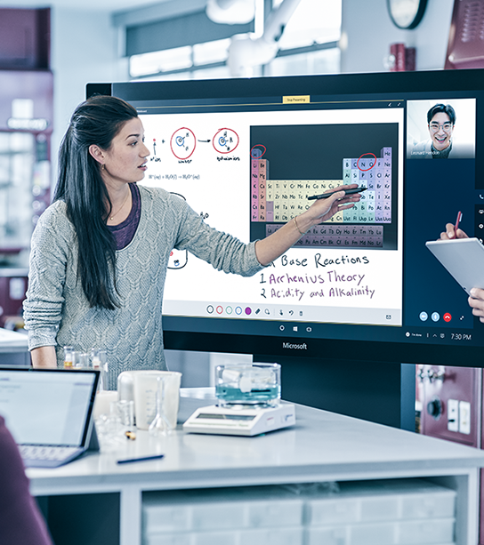
Demo
Hello World

Slide 60
Design Patterns How do you apply
Business Values
Notes:
Talking Points
Derive Business Values
By Knowing what decisions are to be automated and what not
When automation of those decision we rely up on these standard Design Patterns

Slide 61
Patterns
Gang-of-Four Design Patterns
Martin Fowler Patterns of EA Architecture
Eric Evans Domain Driven Design Patterns
Notes:
Talking Points
23 GoF
40 Patterns
3 or more

Slide 62
Design Patterns
“…Solution to commonly occurring IT Problems”
Notes:
Talking Points

Slide 63
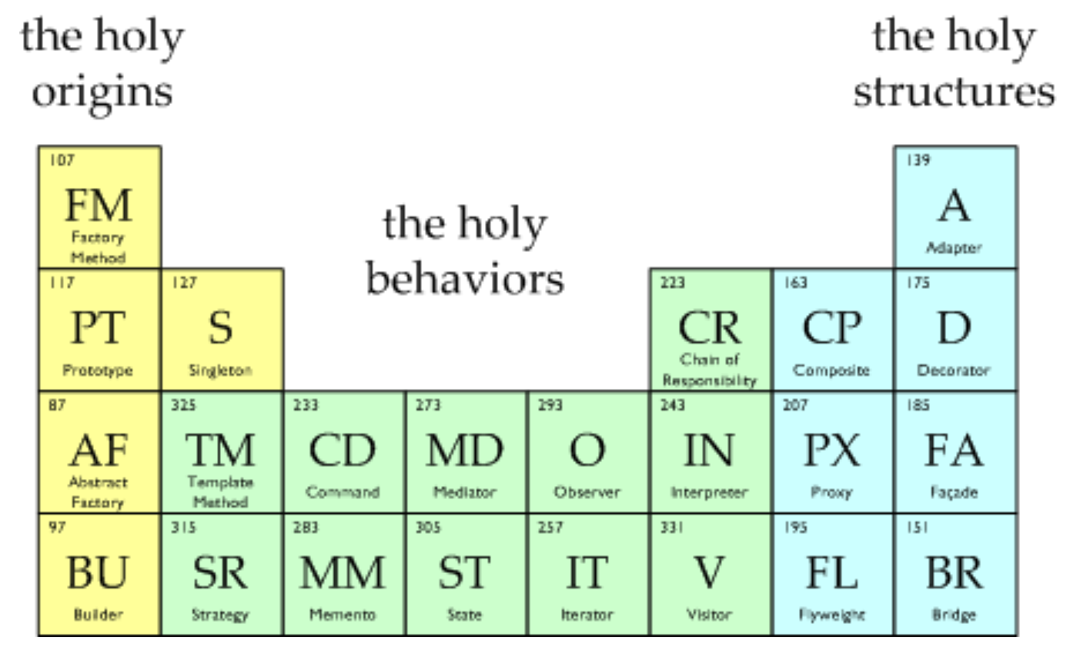
Gang-of-Four Design Patterns
Ref : http://www.vincehuston.org/dp/
#PuneDevCon
Notes:
Talking Points
Map Design Patterns with Expected App Behavior
Creational - Yellow
Behavioral - Green
Structural – Cyan

Slide 64
Catalog of Patterns of Enterprise Application Architecture – Martin Fowler
Domain Logic Patterns
Data Source Architectural Patterns
Object-Relational Behavioral Patterns
Object-Relational Structural Patterns
Object-Relational Metadata Mapping Patterns
Web Presentation Patterns
Distribution Patterns
Offline Concurrency Patterns
Session State Patterns
Base Patterns

Slide 65
Catalog of Patterns of Enterprise Application Architecture – Martin Fowler
Domain Logic Patterns | Transaction Script Domain Model Table Module Service Layer
Data Source Architectural Patterns | Table Data Gateway Row Data Gateway Active Record Data Mapper
Object-Relational Behavioral Patterns | Unit of Work Identity Map Lazy Load
Web Presentation Patterns | Model View Controller Page Controller Front Controller Template View Transform View Two-Step View Application Controller

Slide 66
Catalog of Patterns of Enterprise Application Architecture – Martin Fowler
Distribution Patterns | Remote Facade Data Transfer Object
Object-Relational Structural Patterns | Identity Field Foreign Key Mapping Association Table Mapping Dependent Mapping Embedded Value Serialized LOB Single Table Inheritance Class Table Inheritance Concrete Table Inheritance Inheritance Mappers
Object-Relational Metadata Mapping Patterns | Metadata Mapping Query Object Repository
Offline Concurrency Patterns | Optimistic Offline Lock Pessimistic Offline Lock Coarse Grained Lock Implicit Lock

Slide 67
Catalog of Patterns of Enterprise Application Architecture – Martin Fowler
Session State Patterns | Client Session State Server Session State Database Session State
Base Patterns | Gateway Mapper Layer Supertype Separated Interface Registry Value Object Money Special Case Plugin Service Stub Record Set

Slide 68
Domain Driven Design
CQRS
Specification Pattern
Event Sourcing
Notes:
CQRS - Command Query Responsibility Segration
Specification Patterns – Creating to rules applied to Model, Function, Database
Event sourcing is a strategy wherein we store the transactions, but not the state. When state is required, we simply apply all the transactions from the beginning of time

Slide 69
What is Architecture?

Slide 70
Its about Choices between Designs/Solutions

Slide 71
Architectural Aspect
Response time
Responsiveness
Latency
Throughput
Performance
Load
Load sensitivity
Efficiency
Capacity
Scalability
Notes:
Talking Points
Response Time of request submitted, and response received
Some response, acknowledgement
Network latency impact bandwidth (128kbps ) is application addressing those point / or 20k user whats the latency
Ratio of input / output or for 20k req/ ? Processor is required this talks about Throughput. Throughput is how much stuff you can do in a given amount of time.
All request are catered = high Performance
Load how much stress a system is under, 0.5 seconds with 10 users and 2 seconds with 20 users
Load sensitivity is an expression of how the response time varies with the load
Efficiency is performance divided by resources (30 tps / 2 CPUs which better than 40tps / 4 CPUs)
Capacity maximum effective throughput or load. Highest tipping for Performance degradation
Scalability is a measure of how adding resources (usually hardware) affects performance. Scale up Vs Scale Out

Slide 72
Architectural Aspect
Development
Deployment
Operation
Maintenance
Notes:
Talking Points
Development- A software system that is hard to develop is not likely to have a long and healthy lifetime
Deployment - To be effective, a software system must be deployable. The higher the cost of deployment, the less useful the system is.
Operation - Less dramatic than the impact but a good software architecture communicates the operational needs of the system.
Maintenance – Easability in adding new feature, how flexible the architecture to add new feature, and change existing one

Slide 73


Slide 74
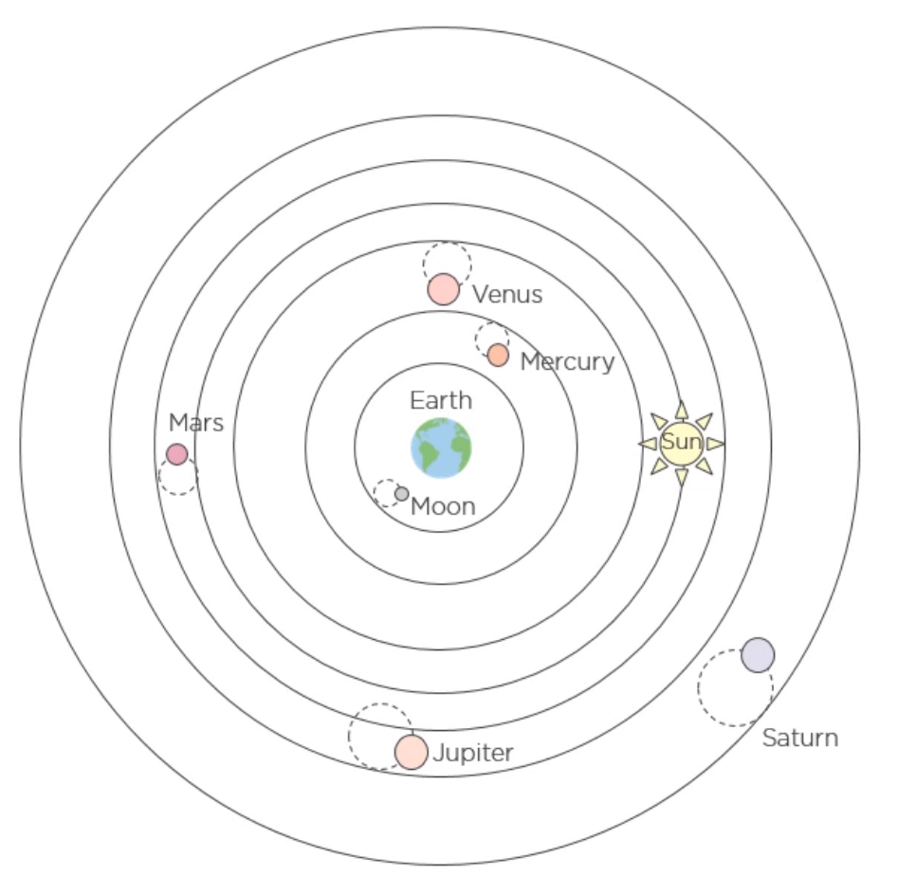
Geocentric Model
#PuneDevCon
Notes:
Talking Points
Nicolaus Copernicus changed the way we look at our solar system in 14th century.

Slide 75
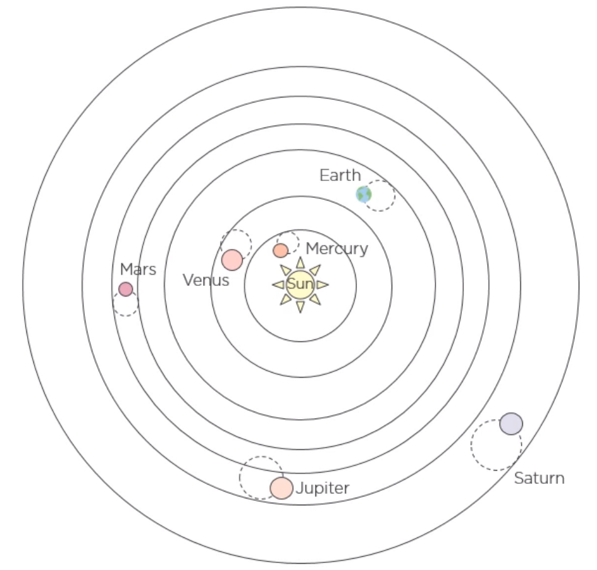
Heliocentric Model
#PuneDevCon
Notes:
Talking Points
Produced a better model of our solar system
A similar shift is happened in Software architecture as well

Slide 76
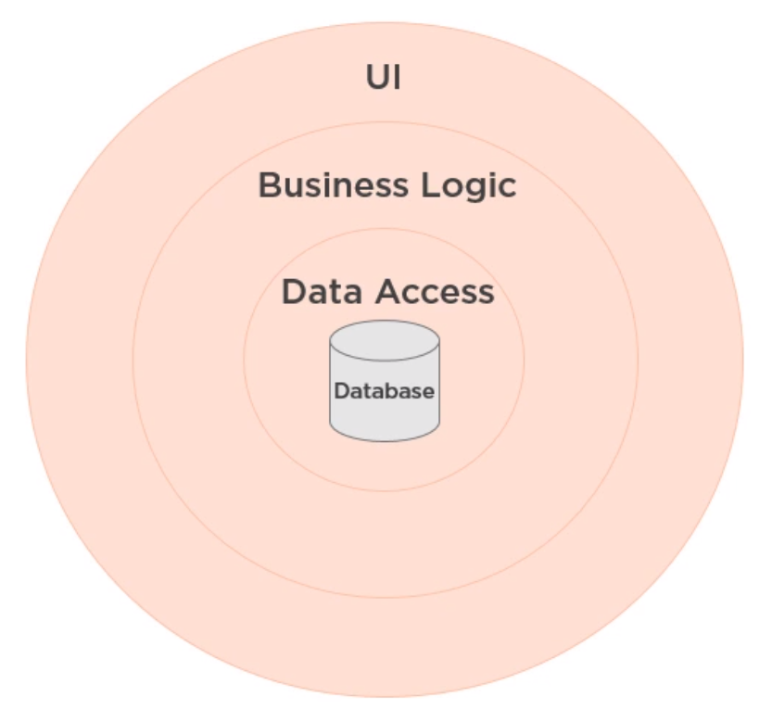
Database Centric Architecture
#PuneDevCon
Notes:
Talking Ponts
Everything revolves around the Database
No harm in having such Architecture

Slide 77
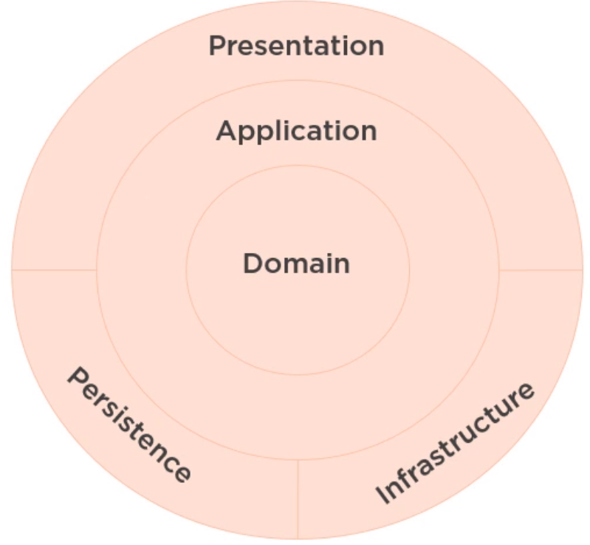
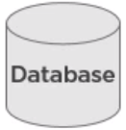
Domain Centric Architecture
#PuneDevCon
Notes:
Talking Points
Database is just to hold the Details
Application/Domain is your “Core”
Rest everything – Presentation/Persistence/Infrastructure is just an implementation

Slide 78
Definition – Robert C Martin (Uncle “Bob”)
“…the first concern of the architect is to make sure that the house is usable, and it is not to ensure that the house is made of brick.”
Notes:
Talking Points

Slide 79
Uncle “Bob” also says…
It’s not about solution is working
Perfect Solution but impossible to change
Vs
Non-workable Solution but easy to changes
Notes:
Talking Points
Impossible to change doesn’t' mean we cannot change, but it has its own challenges
Cost exceed Benefits

Slide 80
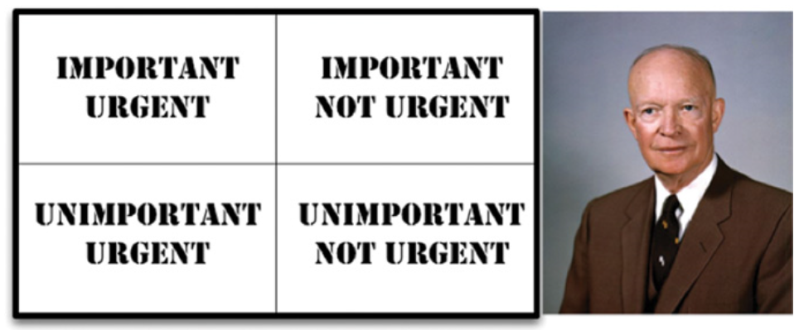
Eisenhower’s Matrix
…the urgent is not important and important is not urgent
Notes:
Talking Points
Urgent things are not given important
Important things is never given any Urgency
Software Value to Bring out : Behavior & Architecture
Architecture is on First Two boxes
Behavior on First and Third Boxes
Business Manager Mistake : Important Architecture is Replaced by Important Feature (Behavior)
Software Developer Hired to take the right Decision. (ASSERT THE IMPORTANT OF ARCHITECTURE)

Slide 81
Fluid Thinking == Flexible Behavior
Fluid Thinking Leads to Fluid Application
Fluid Application Leads to Flexible System
Flexible Behavior Absorb Changes with minimal Brittle-ness
Notes:
Talking Points
App Fluidity decide how flexible is application for changes
Two line of Product, how Application accommodate another Product

Slide 82
Type of Prevalent Architecture Styles
3-Layer
4-Layer
Hexagonal
Onion
Clean Architecture

Slide 83
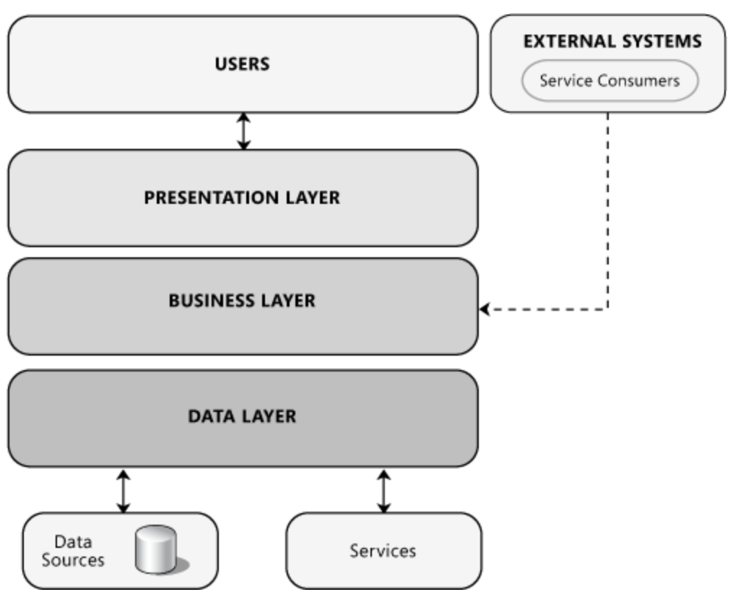
3-Layer Architecture
#PuneDevCon

Slide 84
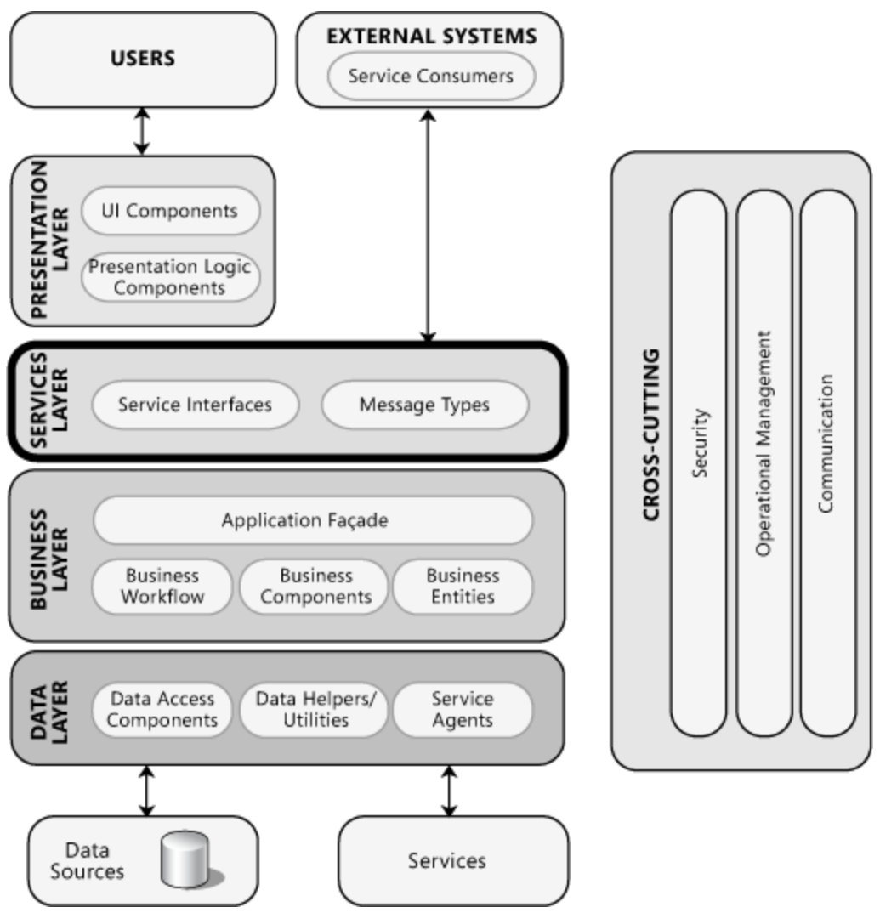
4-Layer Architecture
#PuneDevCon

Slide 85
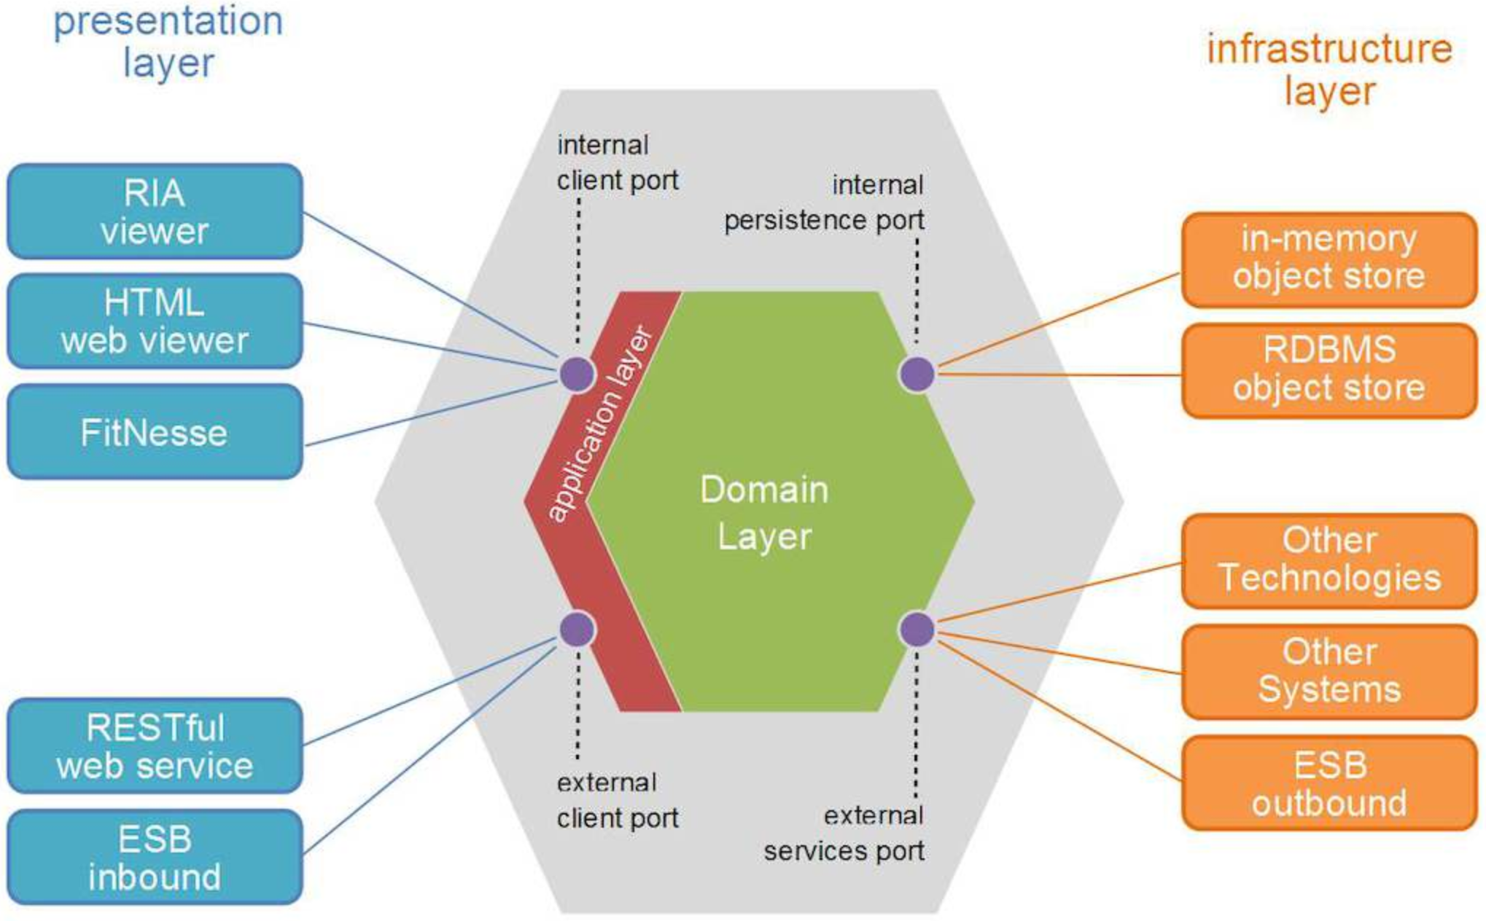
Hexagonal Architecture
#PuneDevCon
Ref: http://tindaloscode.blogspot.com/2013/11/ddd-and-hexagonal-architecture.html

Slide 86
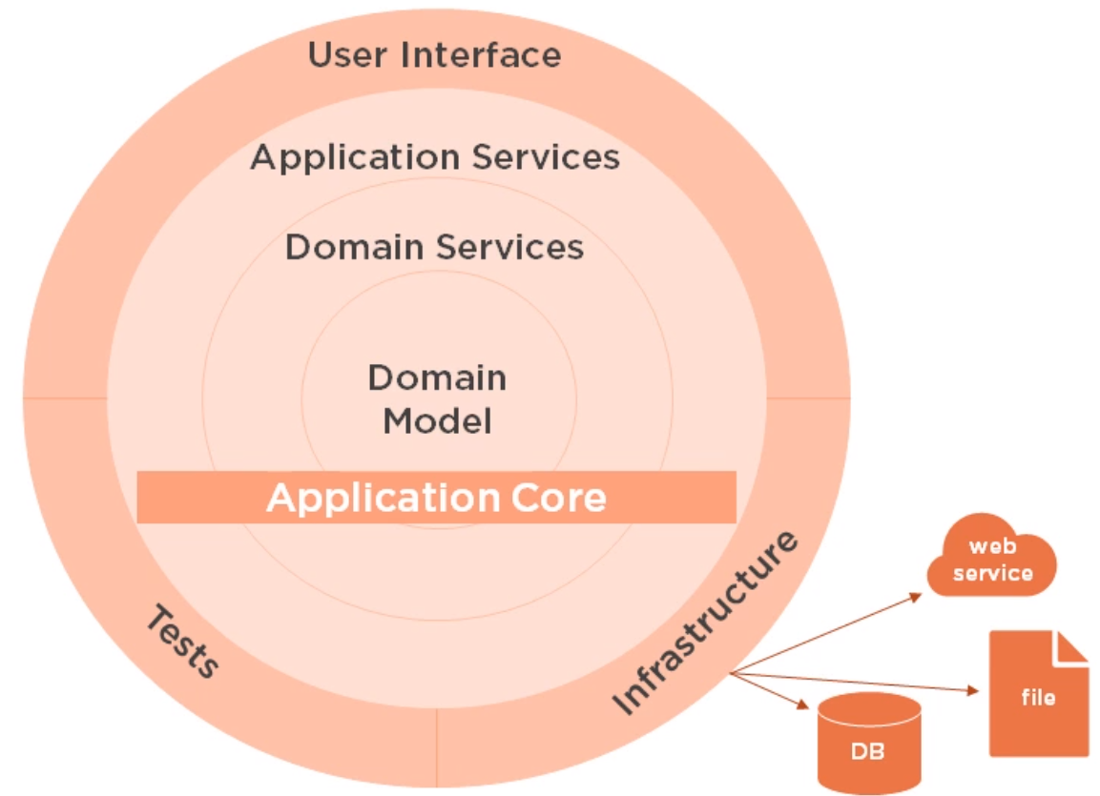
Onion Architecture
#PuneDevCon
Ref: https://jeffreypalermo.com/2008/07/the-onion-architecture-part-1/

Slide 87
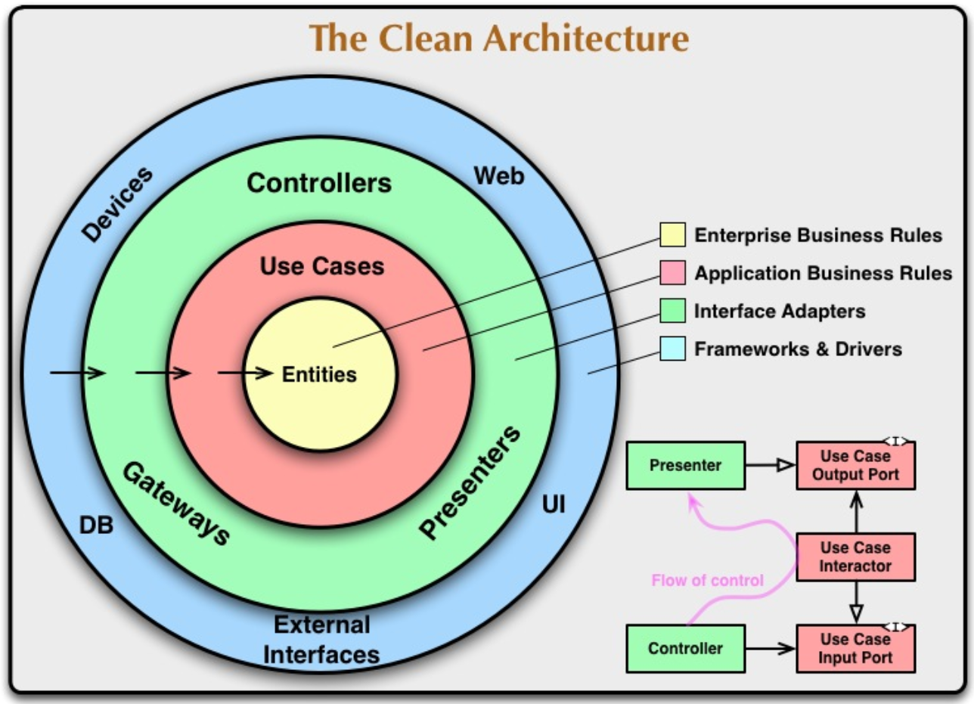
Clean Architecture
#PuneDevCon
Ref: http://blog.cleancoder.com/uncle-bob/2012/08/13/the-clean-architecture.html
Notes:
Talking Points
Entity/Domain – It contains the enterprise wide types and logics
Application/Use case – Contains application specific types and logics
Infrastructure (Incl Persistence) contain all the external concerns
Presentation and Infrastructure depend on the Application
Infrastructure and Presentation components can be replaced with minimal effort
All three (Hexa, Onion and Clean) they are very similar (just change in Terminology)

Slide 88
Pros / Cons of Clean Architecture
Framework Agnostic
TDD so this is Testable
Integrated with any Database
Integrated with any UI (Mobile, Cloud-based, On-Prem)
Any 3rd Part or External Tool can be integrated
Notes:
Talking Points

Slide 89
Screaming Architecture
Notes:
Talking Points
Building Blueprint
Single Family
Library
Electrical Blueprint, Plumbing Blueprint, Structural Blueprint
Framework/Web/Phone/WebAPI this to be deferred
Frameworks are Tools, be Skeptical

Slide 90
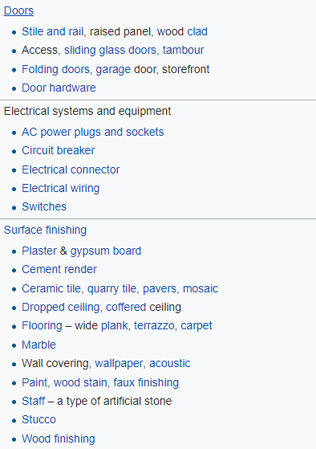
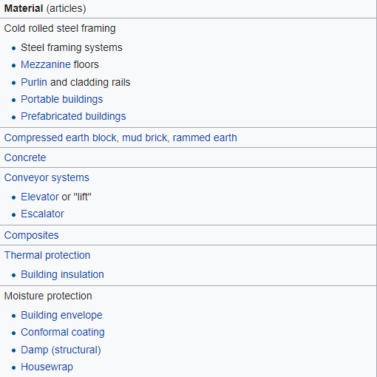
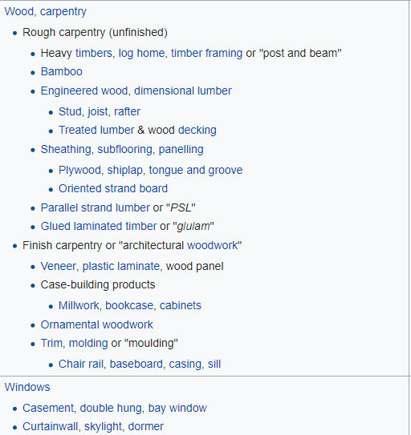
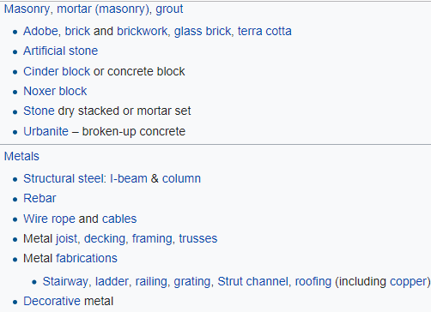
Screaming Architecture

Slide 91
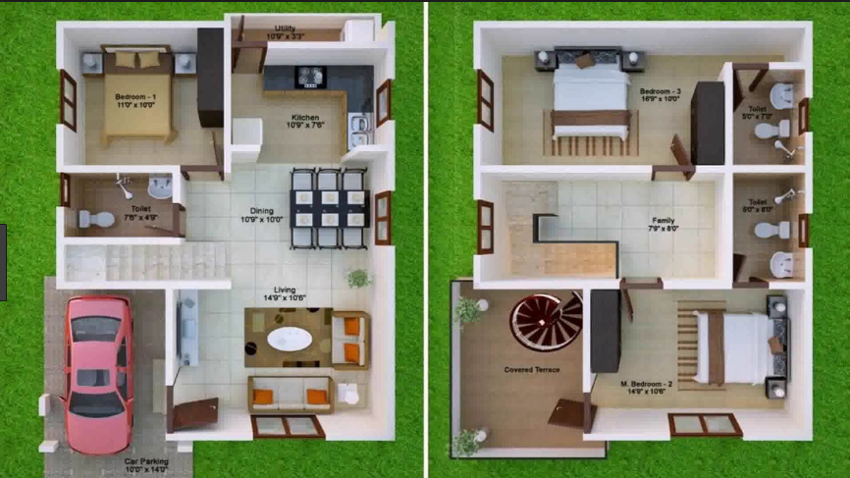
Screaming Architecture

Slide 92
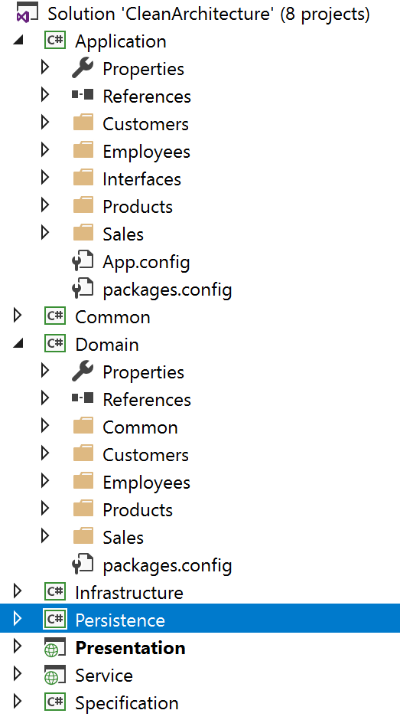
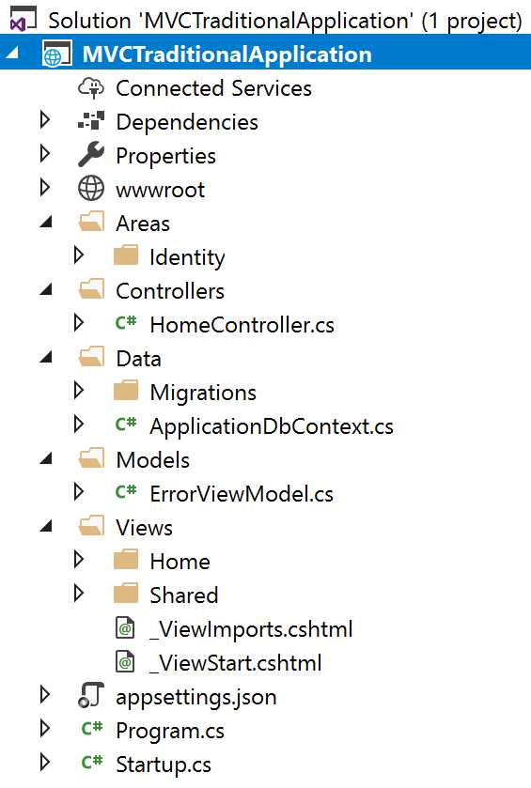
Screaming Architecture

Slide 93

Demo: Clean Architecture
Northwind Traders
.Net Core
EF Core
Code First
Data Seeding Support
☺ ☺ Cross Platform ☺ ☺
☺☺☺ !!!Awesome!!!!

Slide 94
.Net Core Why?
Notes:
Talking Points
Why its important to know about .Net Core & Come with EA Thought Process
Cross Platform (Linux/Window)
Modular
What .Net Core Bring for EA
DI is First class citizen
Middleware (Decorator Pattern)
.Net Identity is first class citizen (FB/Google using Oauth/MFA etc)
Cloud Ready
Container Ready
Orchestrator Ready

Slide 95
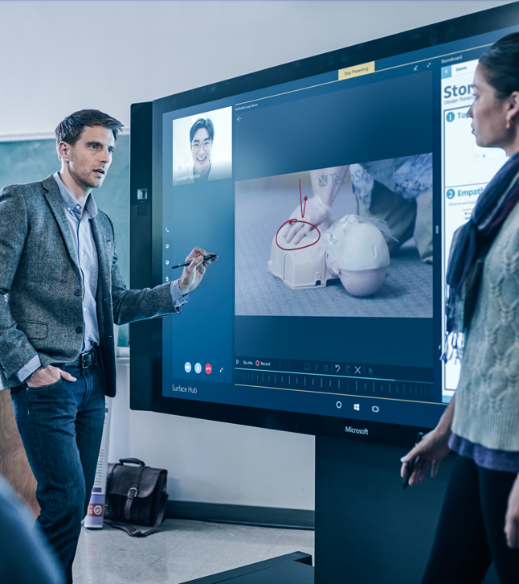
Demo
.Net Core

Slide 96
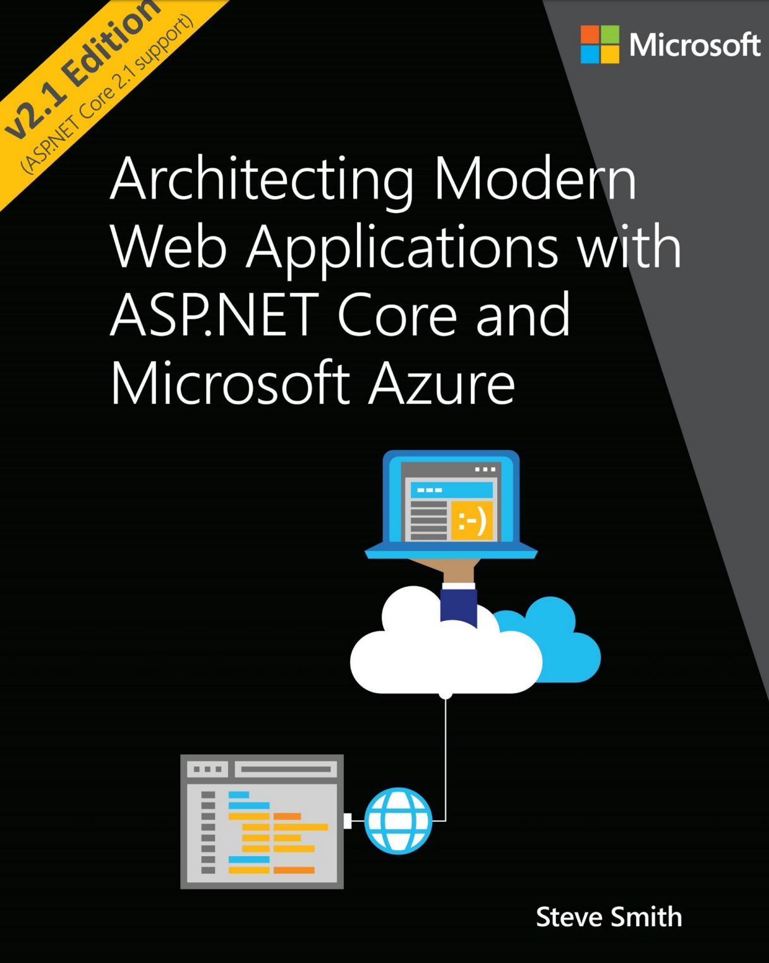
Reference
aka.ms/WebAppEbook
Building Monolith
Clean Architecture
Azure

Slide 97
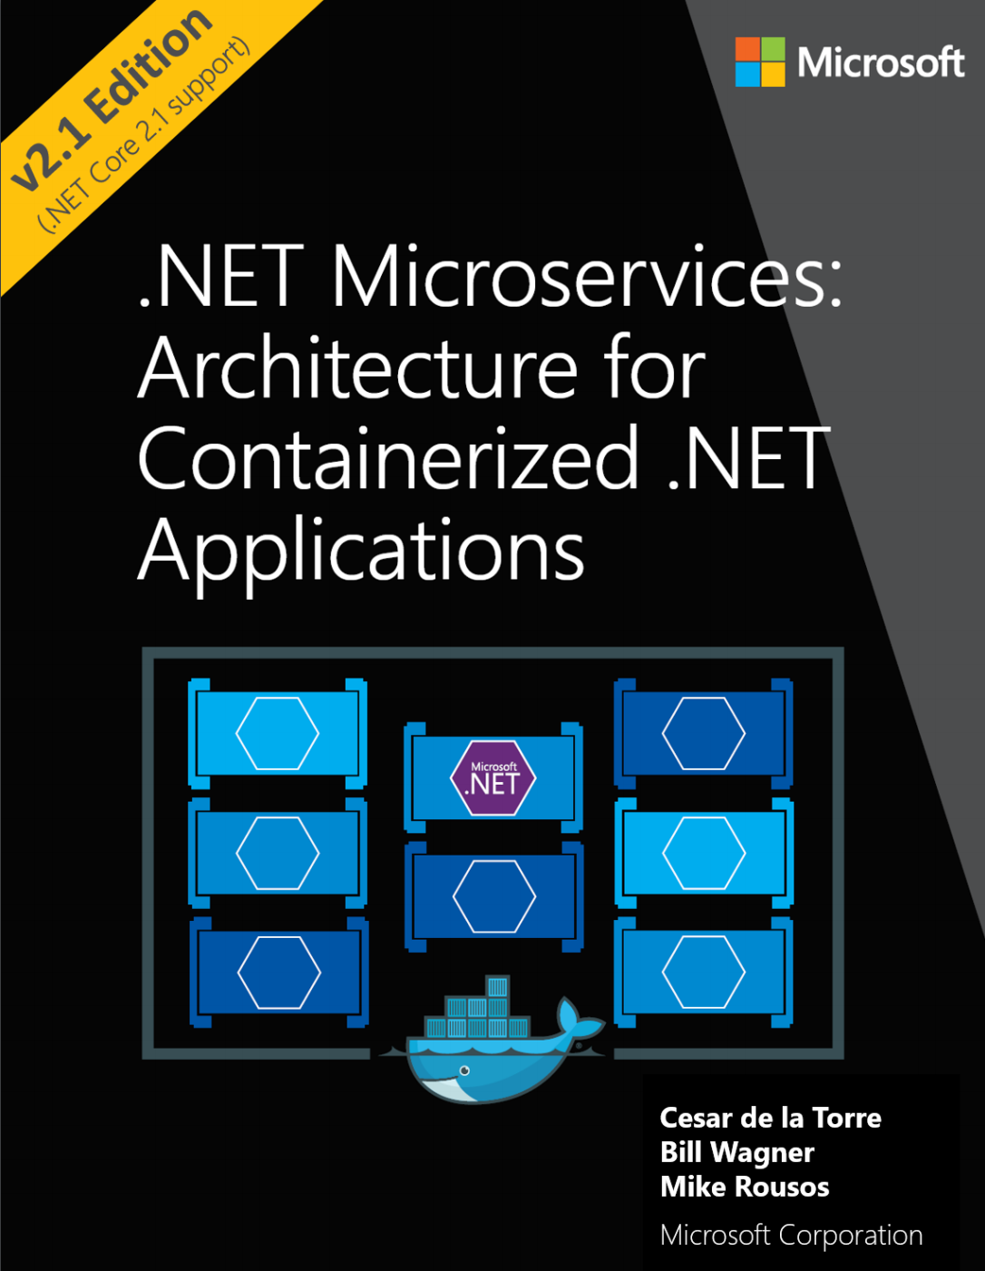
Reference
aka.ms/MicroservicesEbook
Building Microservices
Microservice
Containers
DDD
Azure

Slide 98




Get connected…
http://www.puneusergroup.org
http://www.facebook.com/puneusergroup
http://twitter.com/puneusergroup
http://www.linkedin.com/groups/Pune-User-Group-2023294

Slide 99

Celebrating 14 glorious years of sharing passion
PUG Technology Foundation

